Slide 1
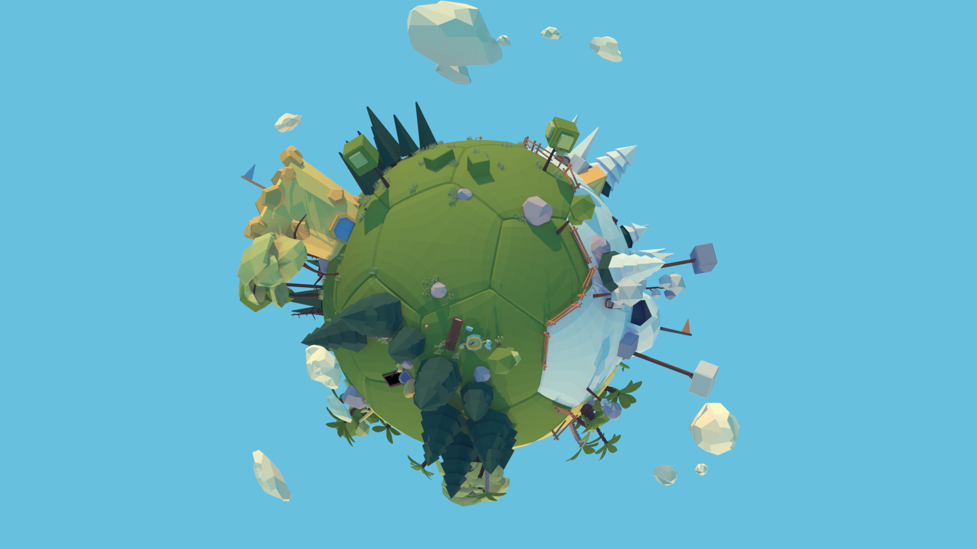
RATTLING RAID
Project: Warrior Infested Planet [WIP]
3D arena-fighting game
Spherical map
King of the Hill Planet
3rd person camera
Platform: PC with controller

Slide 2
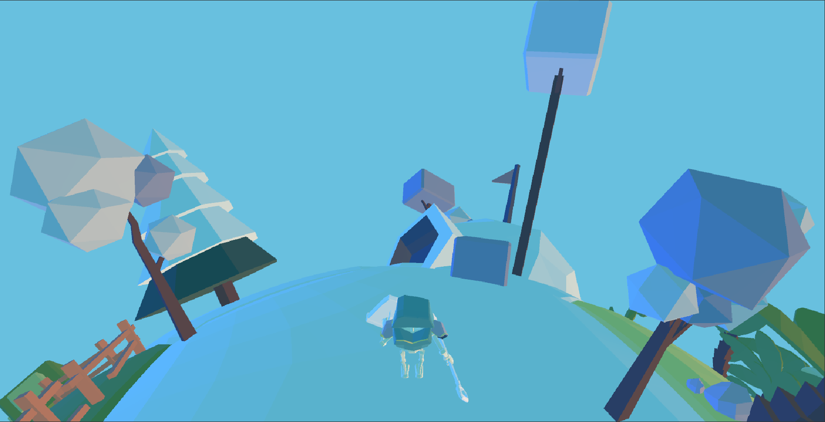
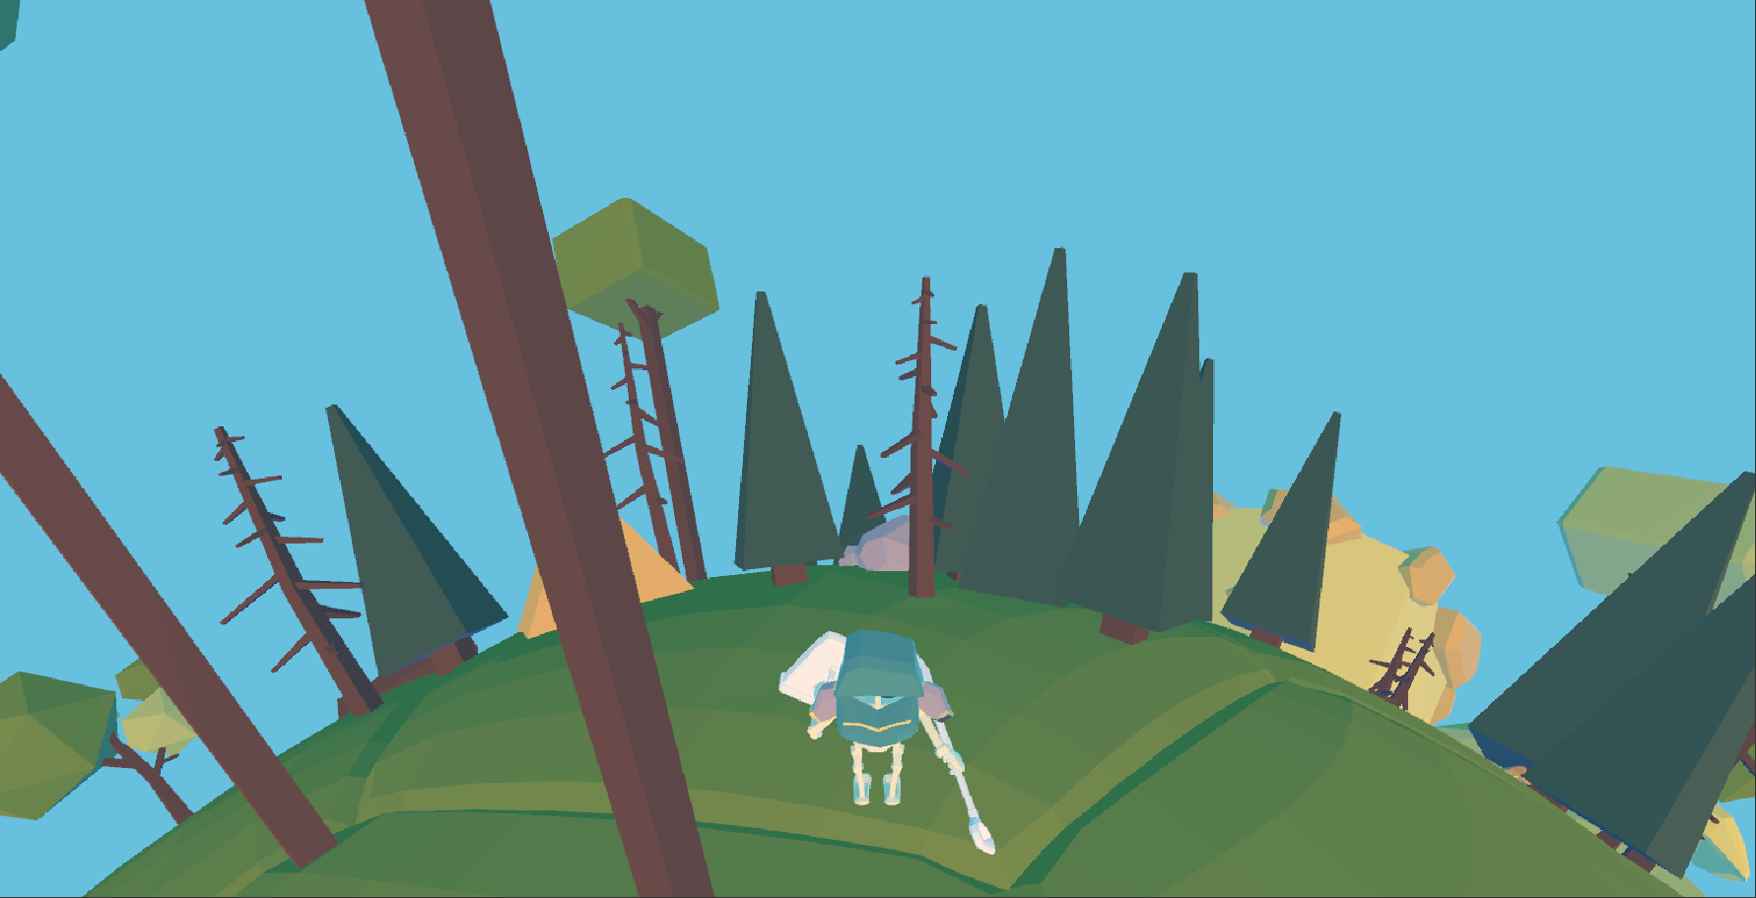
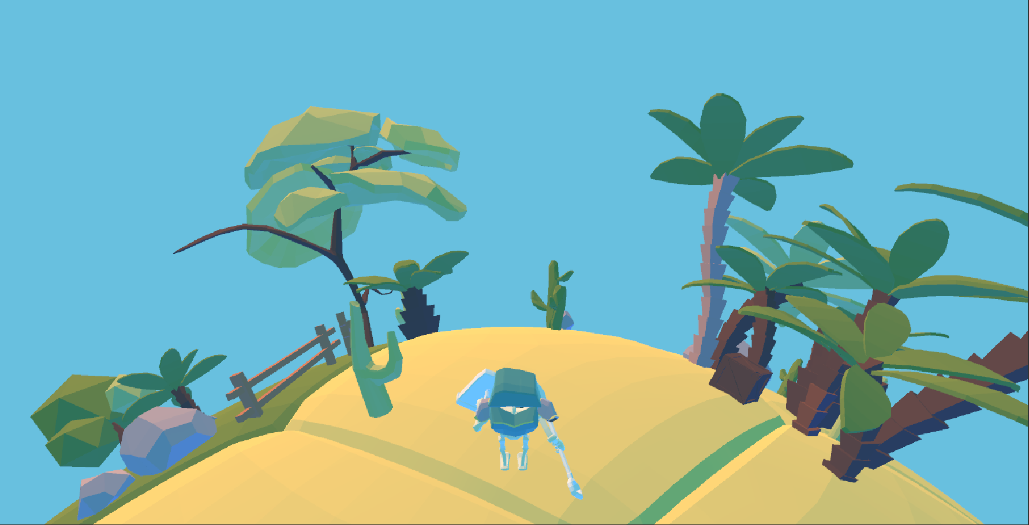
Different areas & buffs
Snowy place
Making snow angels activates stealth for 10s
Buildings
You can use them for cover
Connected teleports
Activatable traps
Desert
Has spots that slow you down
Cactus juice makes your cooldowns shorter

Slide 3
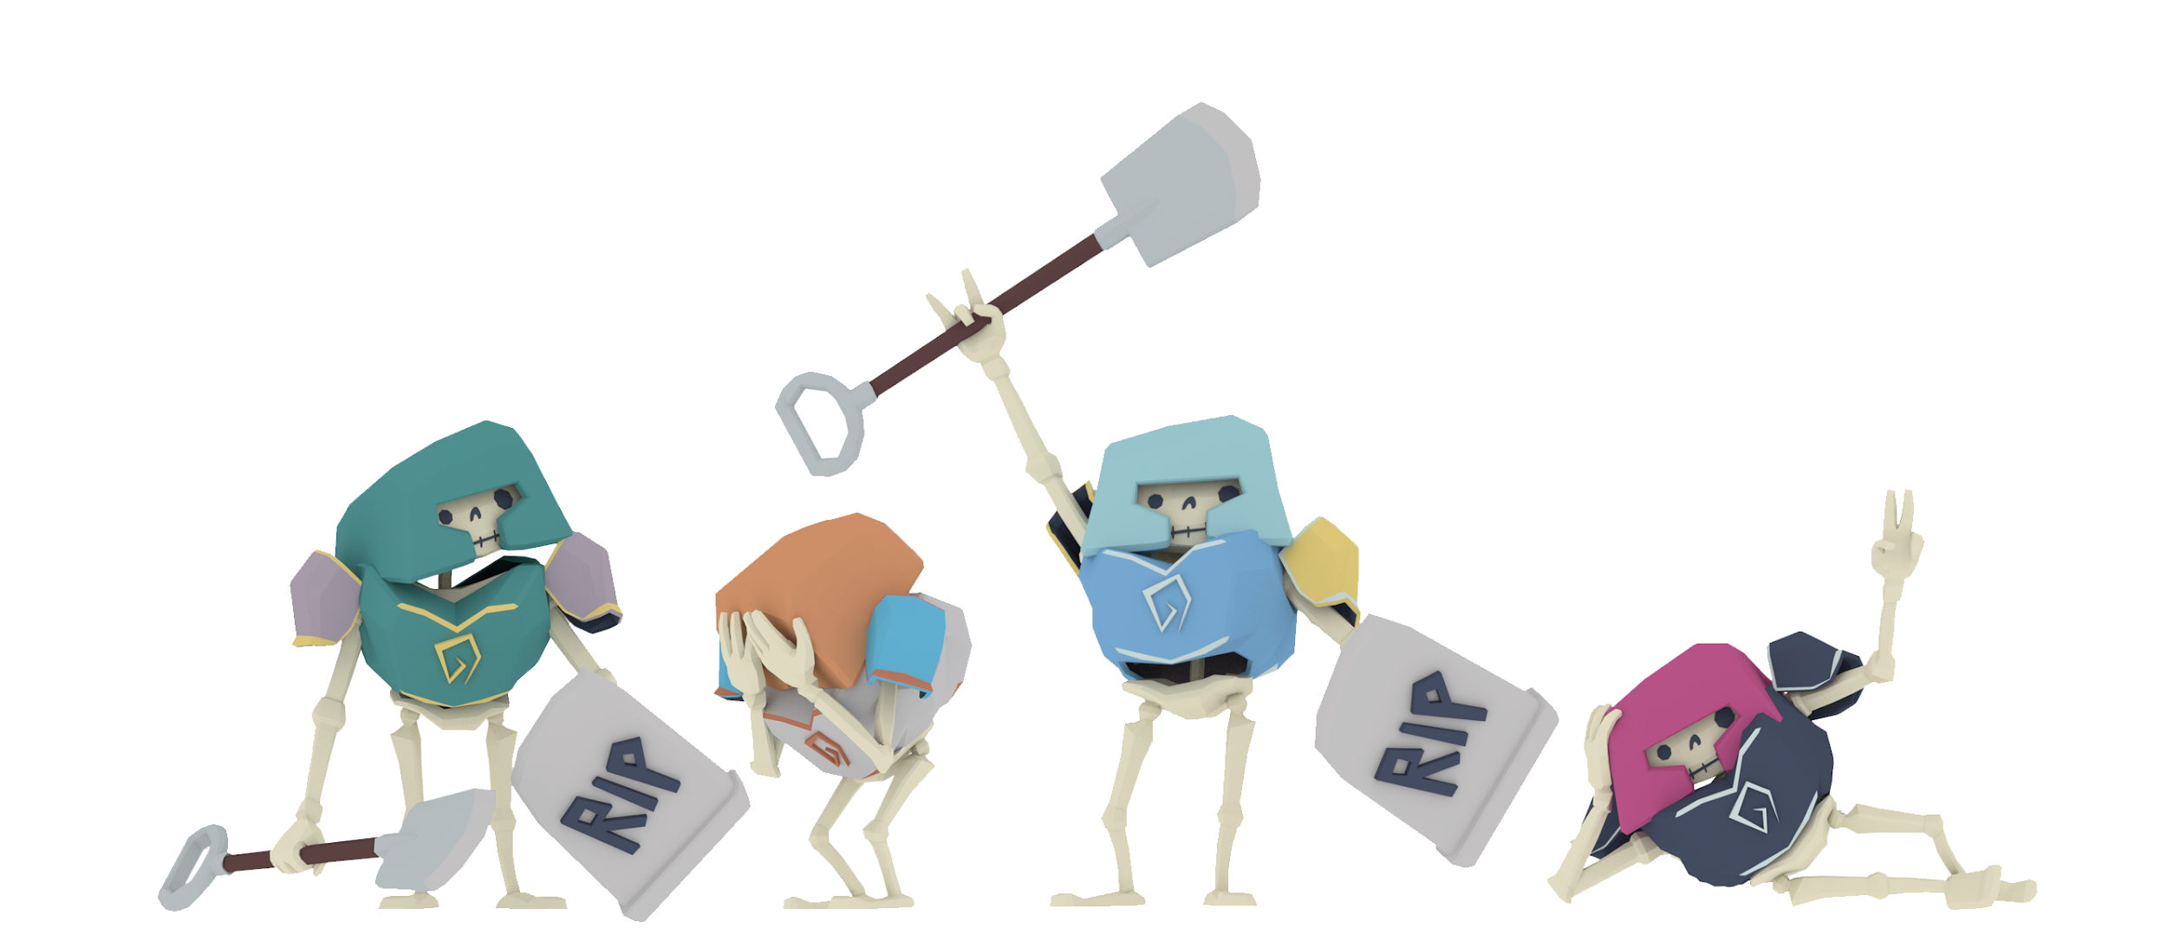
Characters
Work smart, not hard

Slide 4
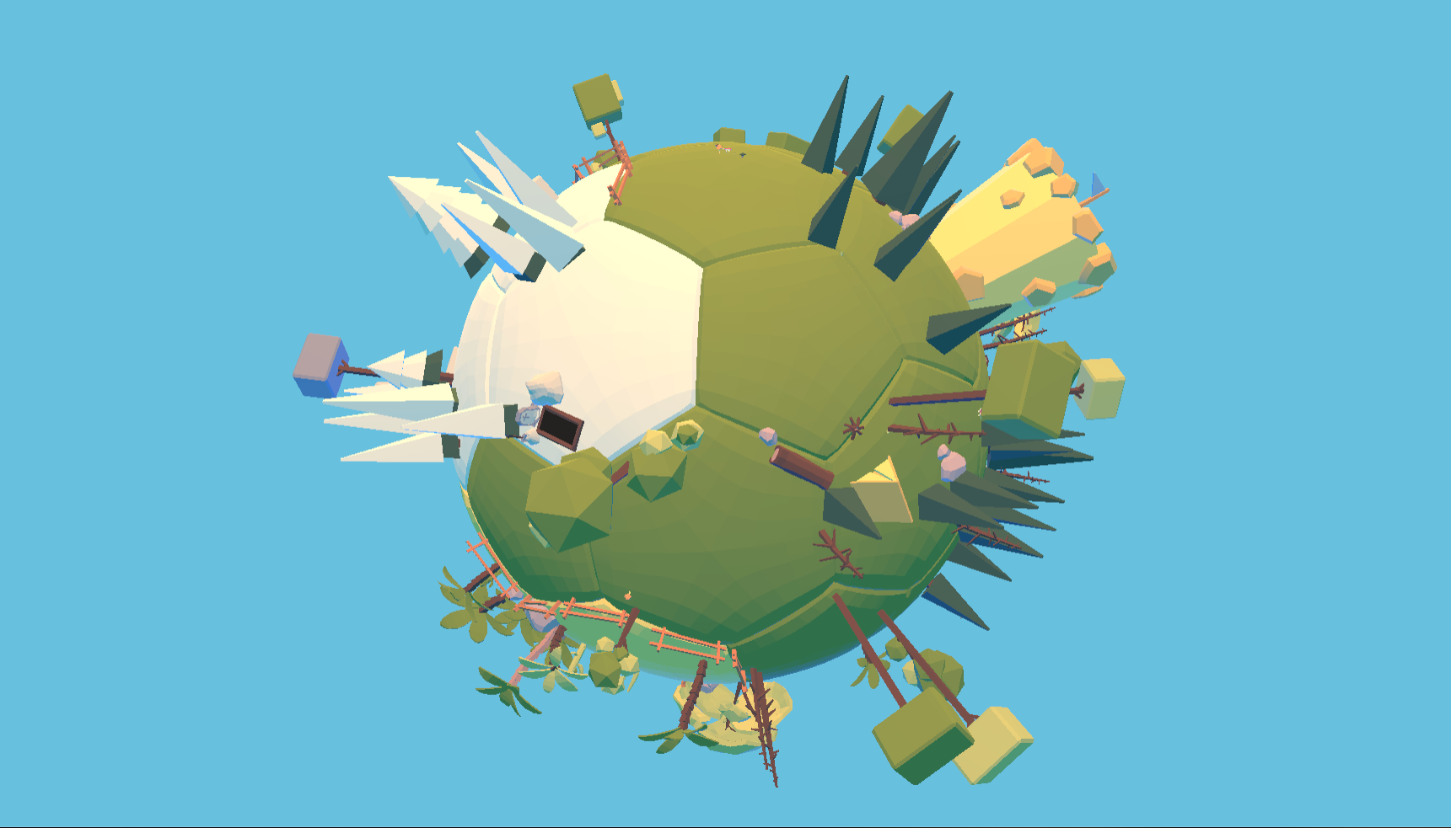
Made of bone and want to be alone
Goal of the game:
be the last skeleton yeeting
Utilize attacks, buffs and structures
to achieve that goal
Target audience: fellow youngsters

Slide 5

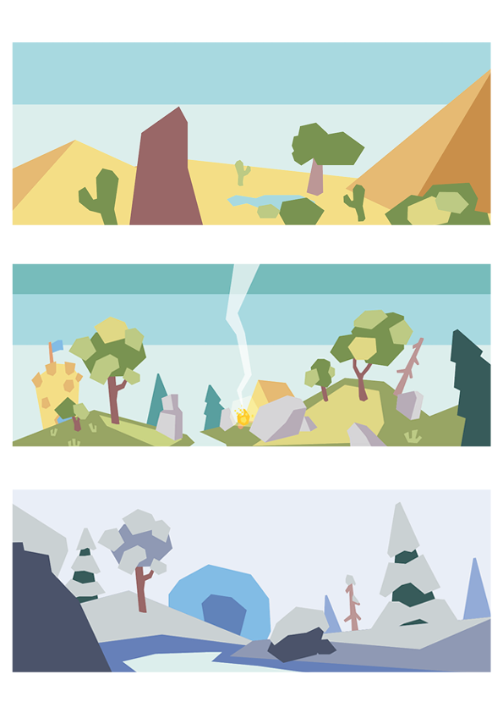
Monetization and pricing
F2P game with skins that only change the appearance of your character
You can also purchase different animations/emotes for your character

Slide 6
Gameplay time!

Slide 7
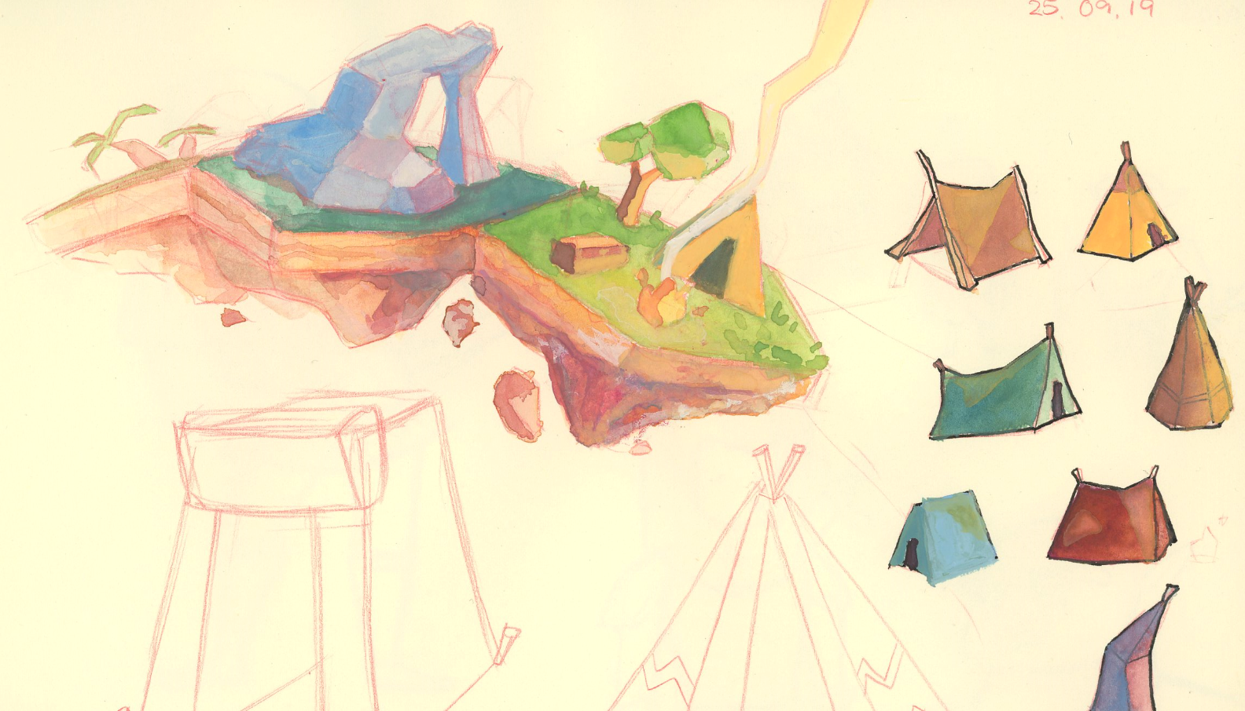
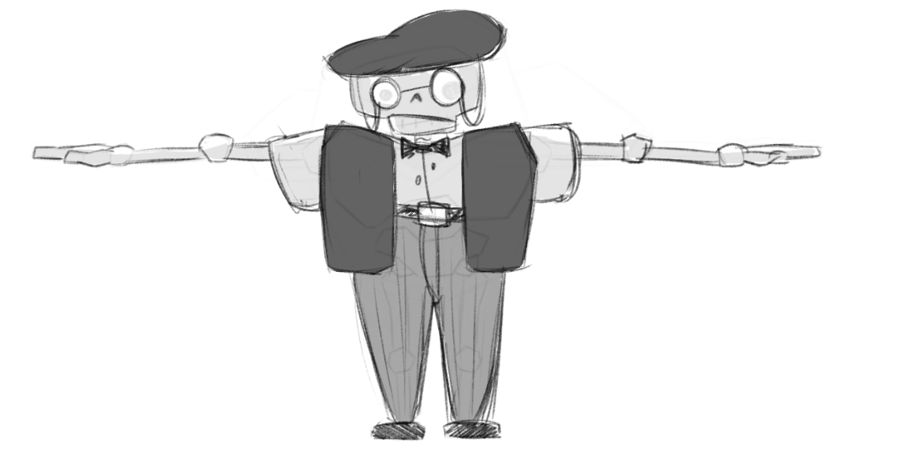
Concepts

Slide 8
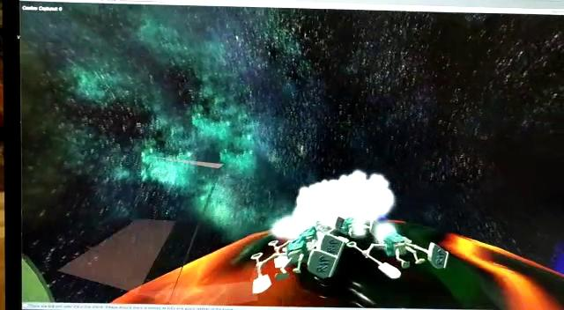
Early development

Slide 9

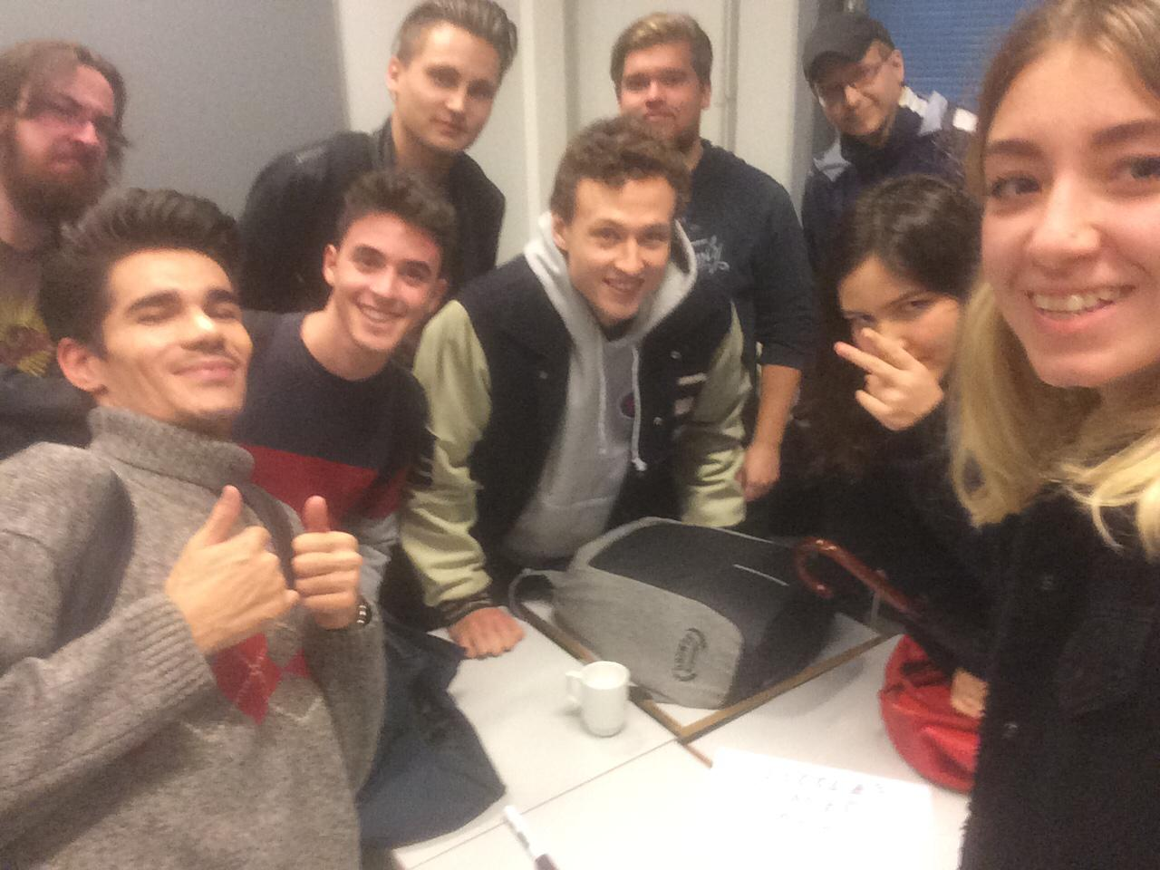
The Team
Game Lead
Programmers
Art Lead
Artists
Producer
Composer

